Slide 1
Lorenzo Code Coverage

Slide 2
Code Coverage:
Measures the quality of software testing and how much source code is executed

Slide 3
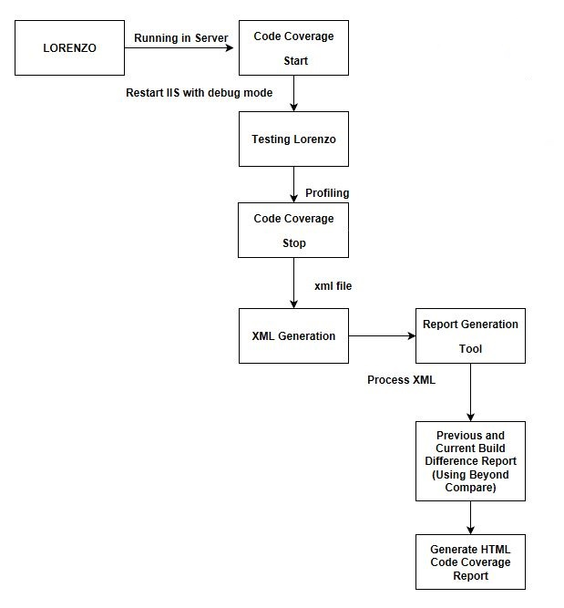
Code Coverage Architecture

Slide 4
Thanks You

